Slide 1

16-791 Hw1:
Data Mining for A
Real Estate Agency
By Elissa Ye
Spring 2018

Slide 2
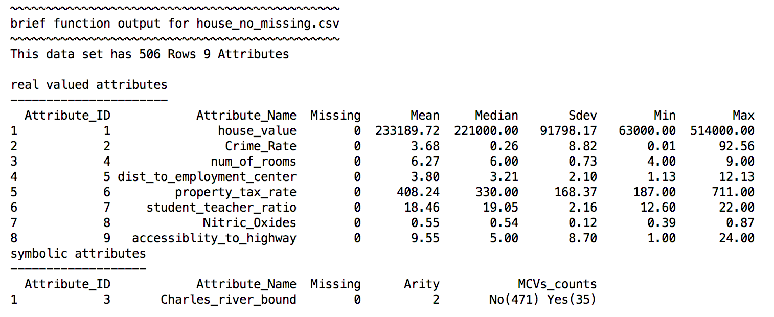
Q1: Descriptive Statistics

Slide 3
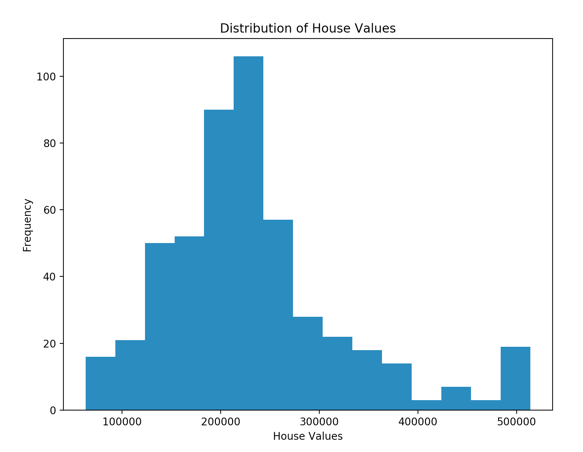
Q1: Distribution of House Values

Slide 4
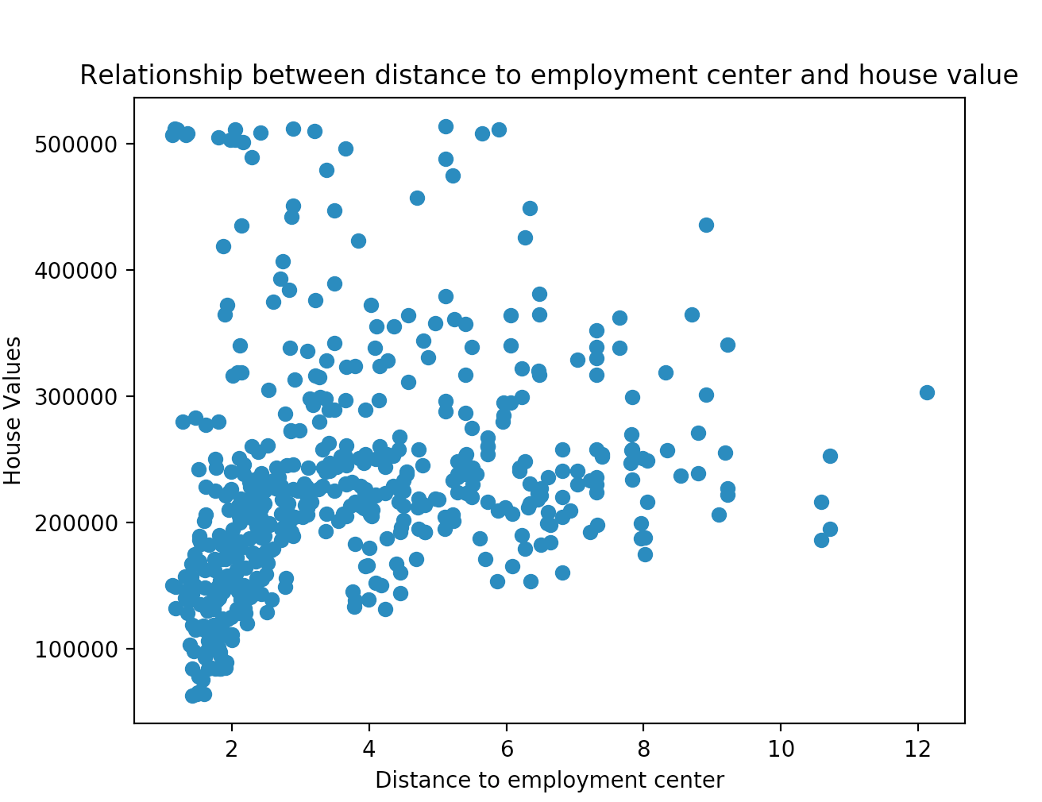
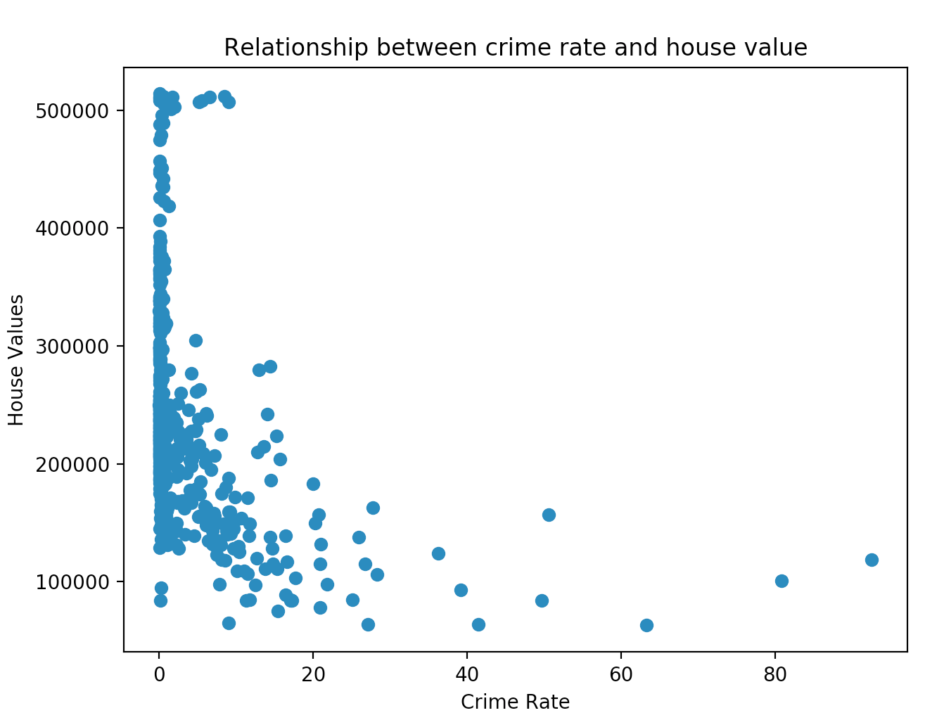
Q1: Relationships with House Values (1)
How does crime rate affect house value?
  Could there be a negative correlation?
How does distance to employment center affect house value?
  Could there be a positive correlation? Could there be a hidden variable accounting for this?

Slide 5
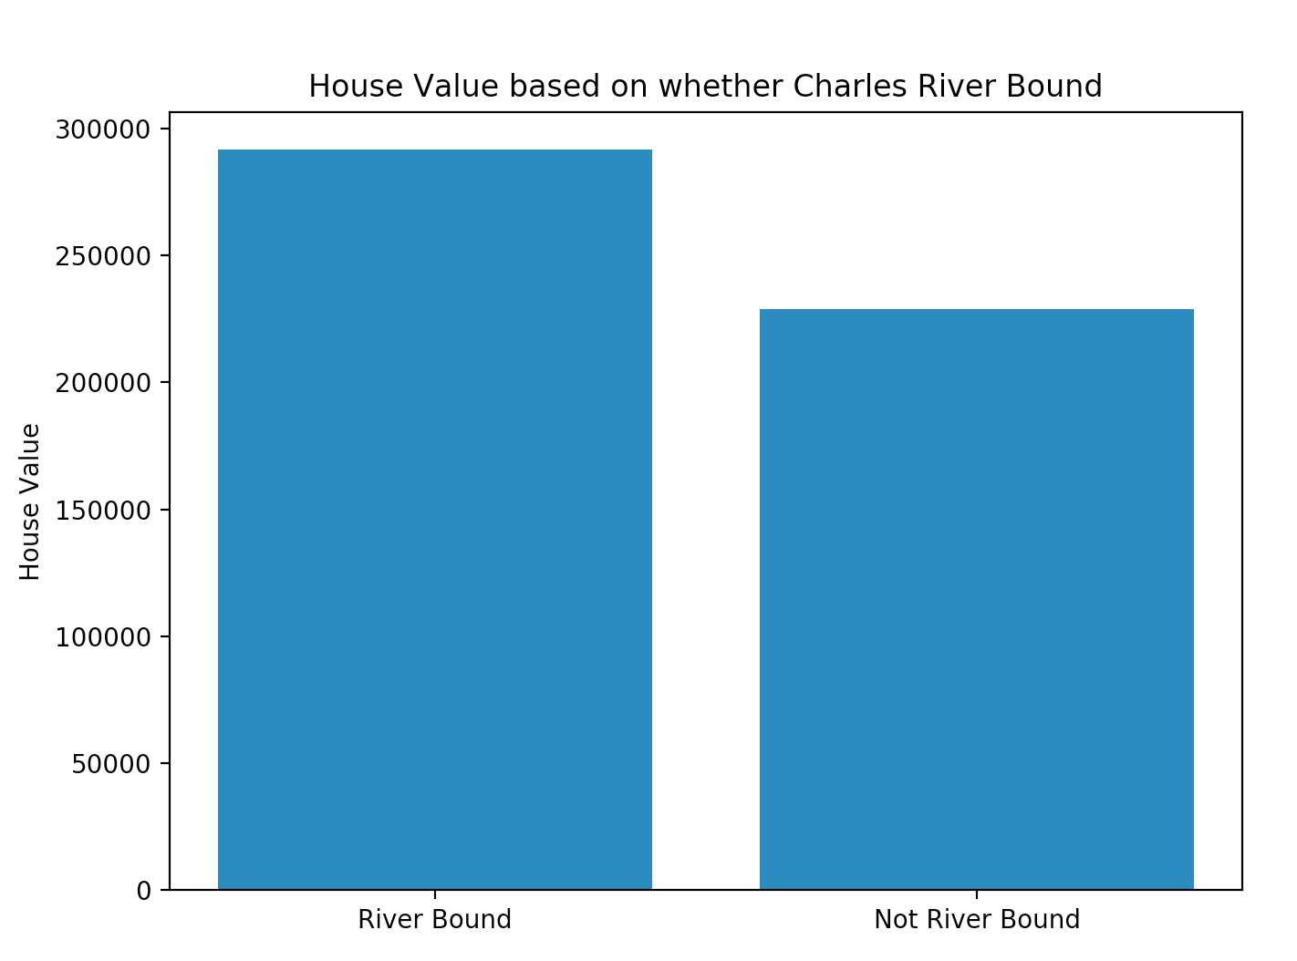
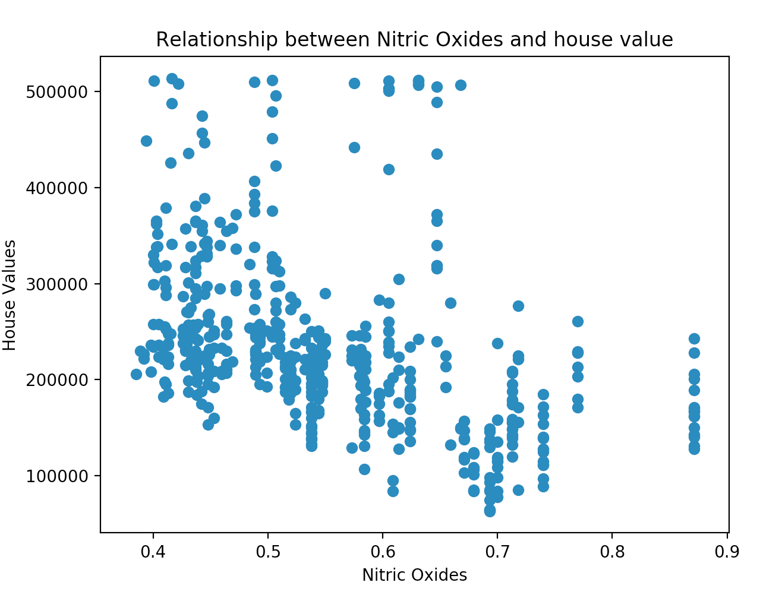
Q1: Relationships with House Values (2)
How does nitric oxide in the environment affect house value?
  Could there be a negative correlation?
Does being Charles River Bound significantly impact house value?

Slide 6
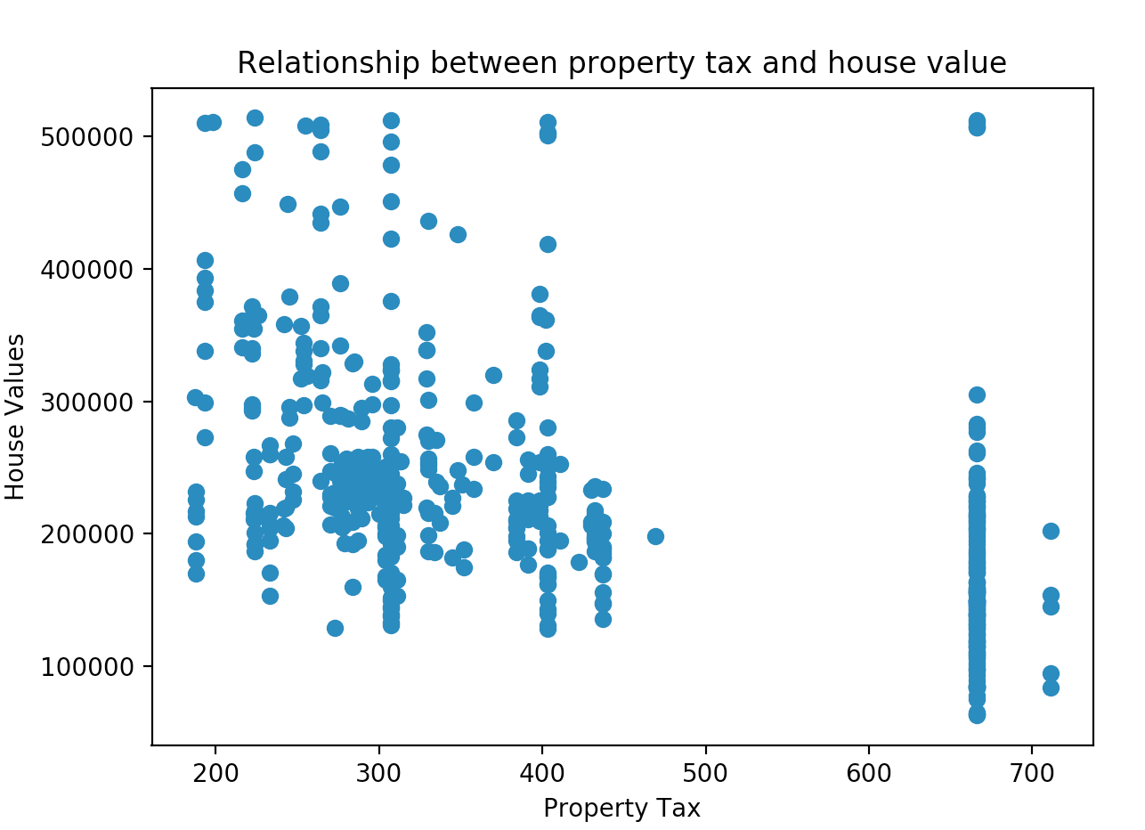
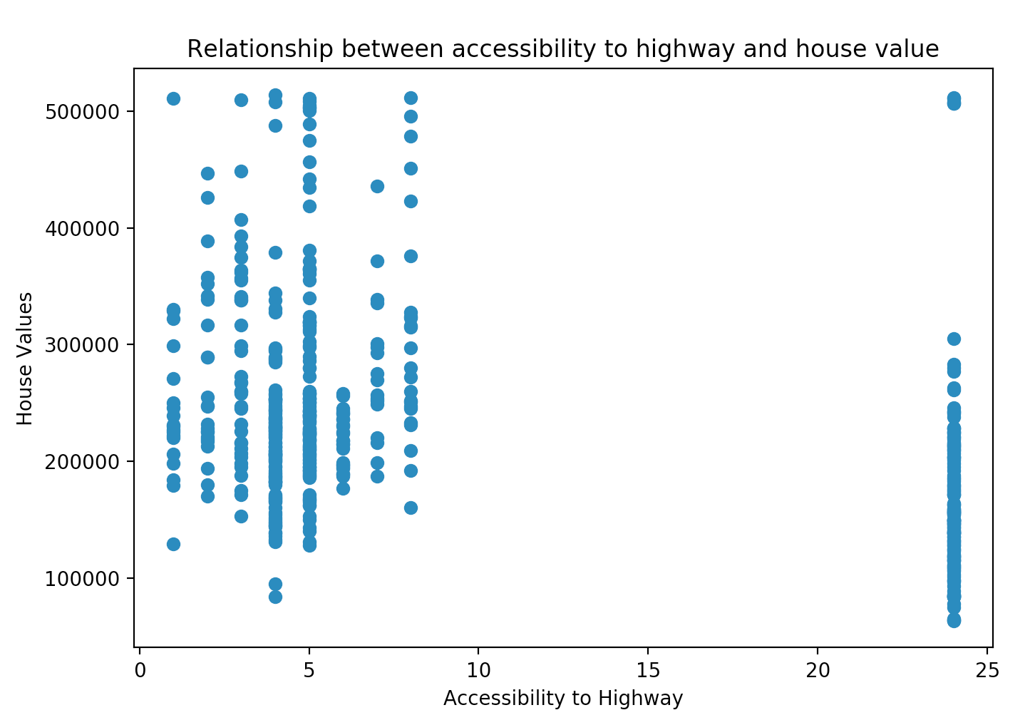
Q1: Relationships with House Values (3)
What are the group of houses with high accessibility to highway and high property tax?
Could accessibility to highway and property tax be related?

Slide 7
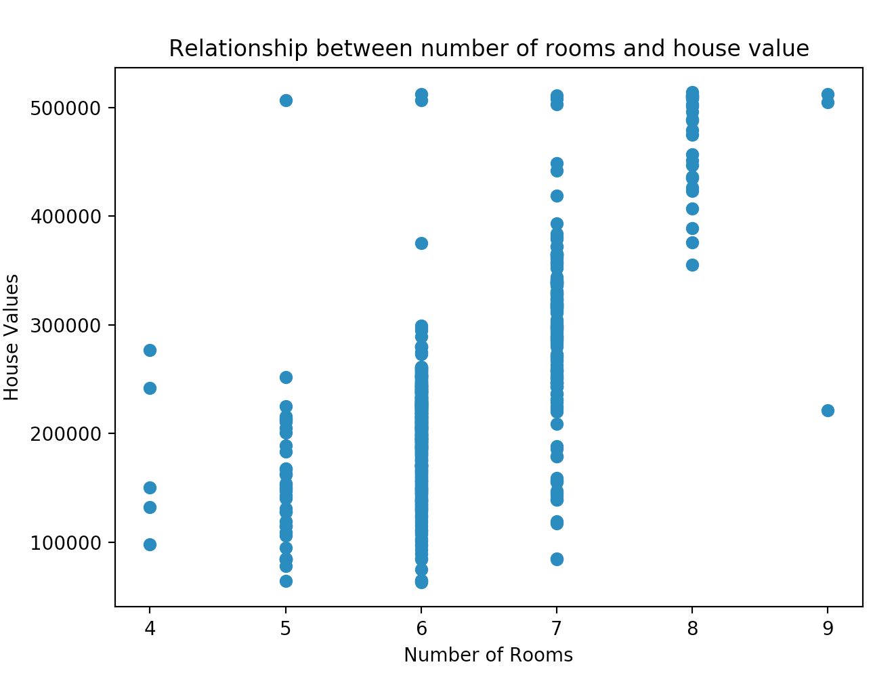
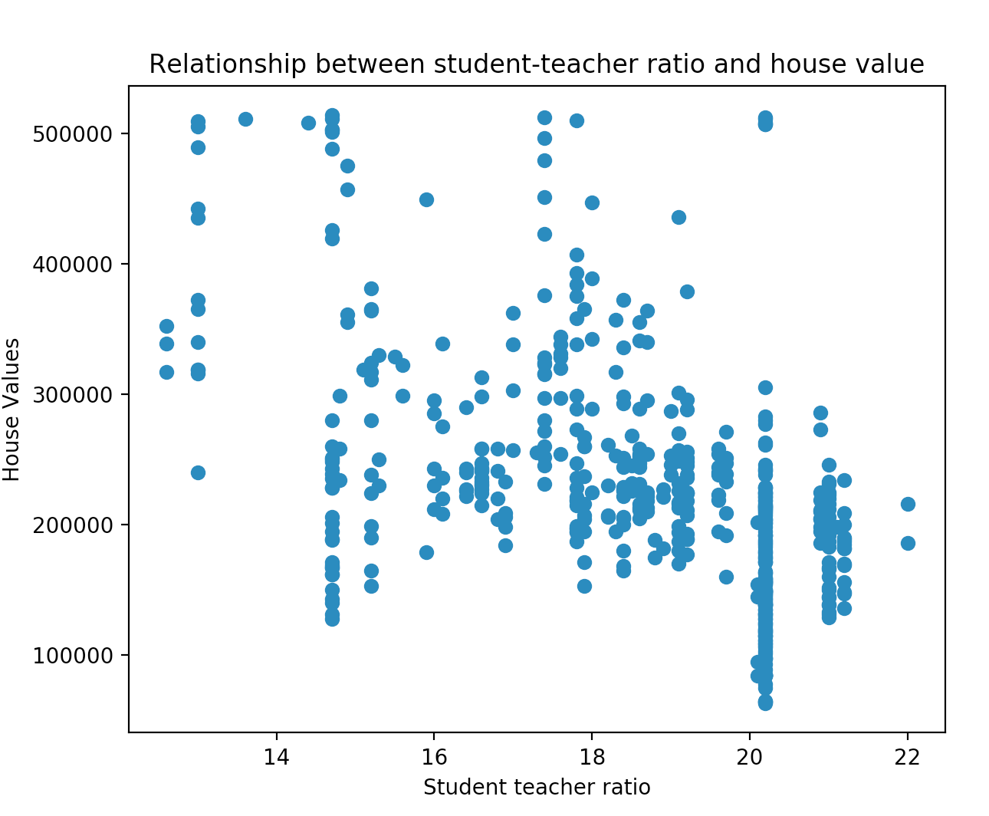
Q1: Relationships with House Values (4)
How does the number of rooms impact house value?

Slide 8
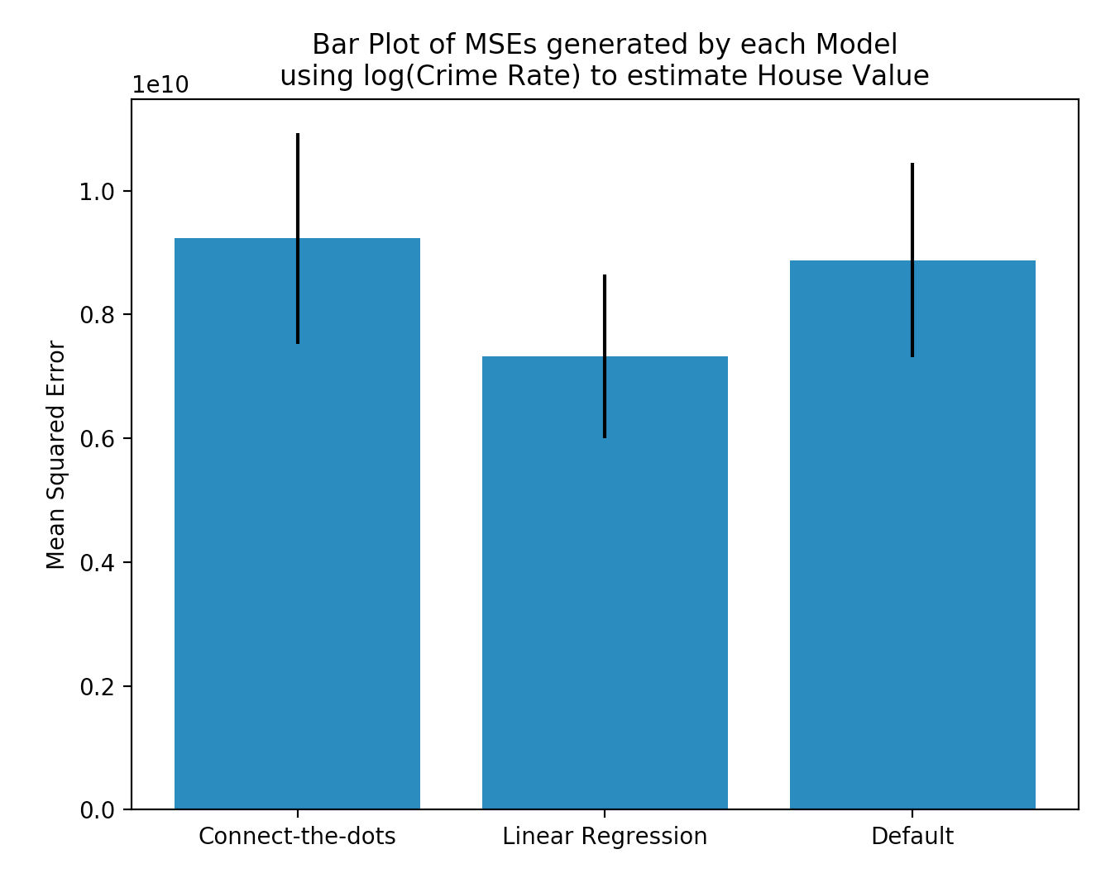
Q2: Applying leave-one-out cross-validation for three models
The results of the leave-one-out cross validation suggests that the linear regression model is the best predictor out of all three models
The connect-the-dots model only performs slightly better than the default model
All standard error ranges are about the same
In practice, we would select the linear regression model as the most suitable model to re-train all available data
95% Confidence Intervals:
Connect-the-dots: 9306100790 +-1702405998
Linear regression: 7326038345 +- 1327847983 Default: 8875201581 +- 1569993198

